Slide 1
ULTRASONIC RANGE SENSING
15CSU254
VARUN AHUJA

Slide 2
ABOUT
This Project is all about finding distance through Ultrasonic Sensors and display it on LCD. If the distance is below 10cm, LED will glow and Buzzer will buzz for that particular Ultrasonic Sensor. It will also generate e-mail alert for the user from NODE-RED.

Slide 3
Components Required
Arduino Mega 2560 or Arduino UNO
Ultrasonic Sensors
LCD Display
Breadboard
Jumper Wires(Both M to M and F to M)
Buzzers
LEDs
Resistors(220 Ohm)
Potentiometer(10 KOhm)

Slide 4
Softwares Required
Arduino IDE
NODE-Red

Slide 5
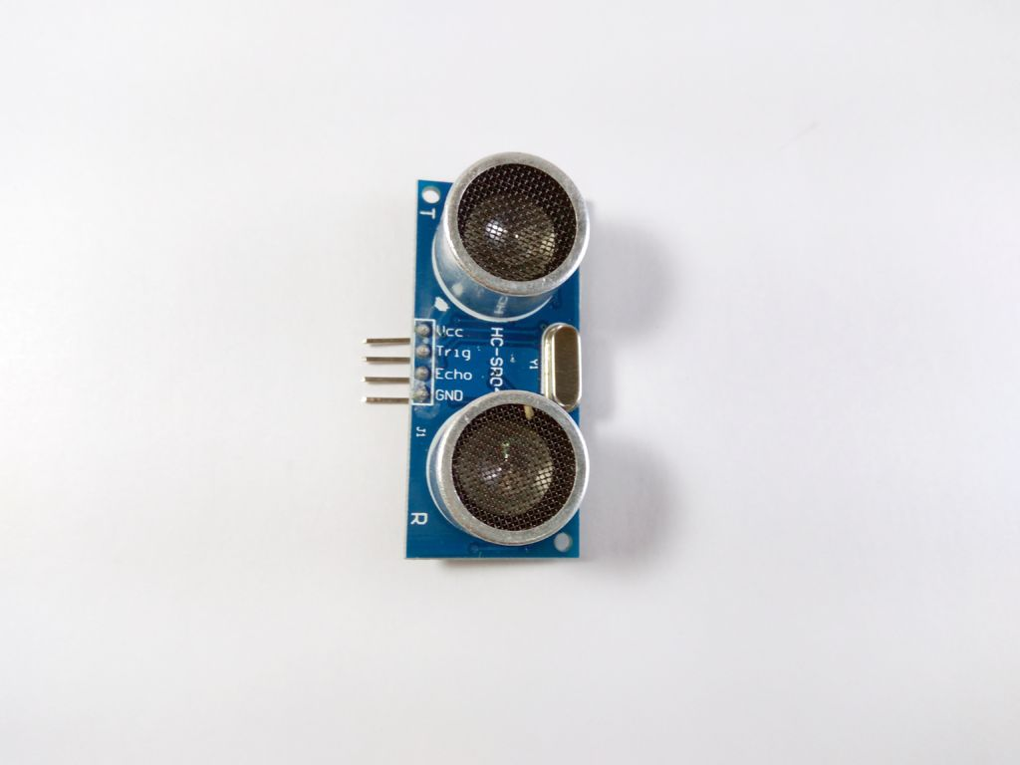
Ultrasonic Sensor
An Ultrasonic sensor is a device that can measure the distance to an object by using sound waves. It measures distance by sending out a sound wave at a specific frequency and listening for that sound wave to bounce back. By recording the elapsed time between the sound wave being generated and the sound wave bouncing back, it is possible to calculate the distance between the sonar sensor and the object.
It can measure the distance upto 3 metres

Slide 6
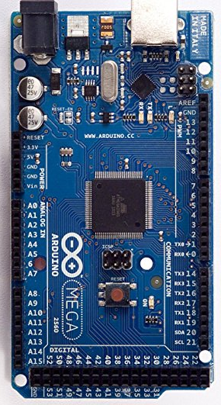
Arduino Mega 2560
Microcontroller | ATmega2560
Operating Voltage | 5V
Input Voltage (recommended) | 7-12V
Input Voltage (limit) | 6-20V
Digital I/O Pins | 54 (of which 15 provide PWM output)
Analog Input Pins | 16
DC Current per I/O Pin | 20 mA
DC Current for 3.3V Pin | 50 mA
Flash Memory | 256 KB of which 8 KB used by bootloader
SRAM | 8 KB
EEPROM | 4 KB
Clock Speed | 16 MHz
LED_BUILTIN | 13
Length | 101.52 mm
Width | 53.3 mm
Weight | 37 g

Slide 7
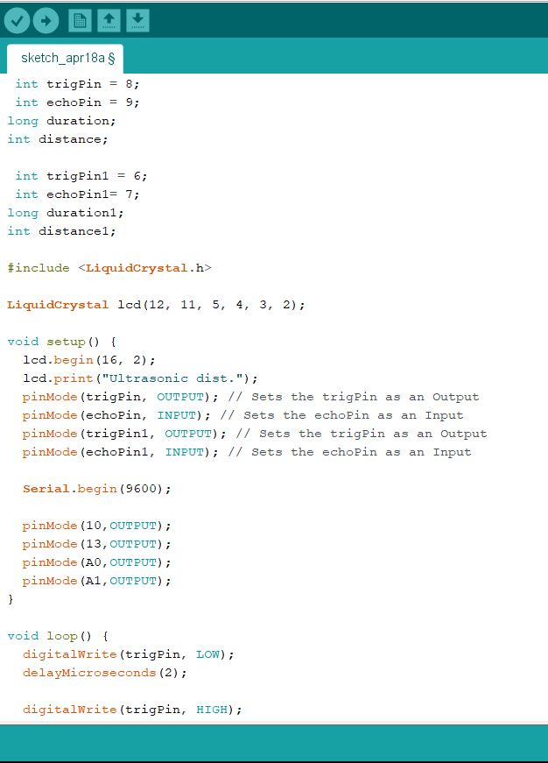
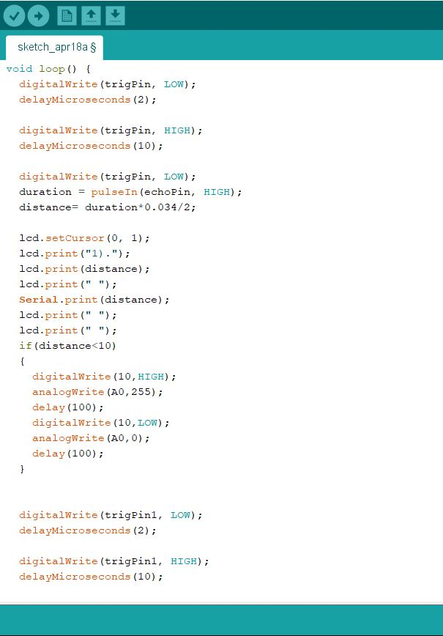
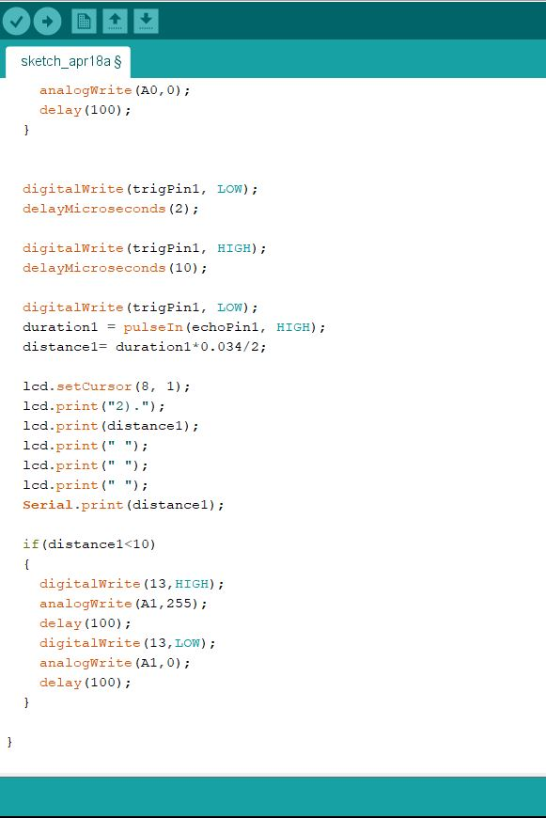
CODE

Slide 8
Applications
Smart Garage
Driverless cars
Various Toys(cars,bikes,etc)

Slide 9
Thank You

